Slide 1

Computer Organization And Architecture
CSE-209
Lecture – 08
Al Bashir
Lecturer, Dept. of CSE
Dhaka International University

Slide 2
Content
Set Associative Mapping
Pentium-4 cache architecture

Slide 3
Set Associative Mapping
Cache is divided into a number of sets
Each set contains a number of lines
A given block maps to any line in a given set
e.g. Block B can be in any line of set i
e.g. 2 lines per set
2 way associative mapping
A given block can be in one of 2 lines in only one set

Slide 4
Set Associative Mapping Example
13 bit set number
Block number in main memory is modulo 2¹³
000000, 00A000, 00B000, 00C000 … map to same set

Slide 5
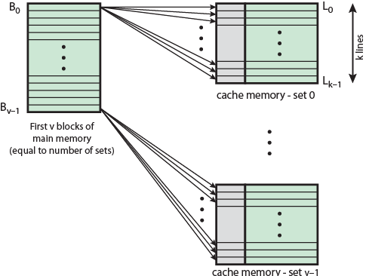
Mapping From Main Memory to Cache: v Associative

Slide 6
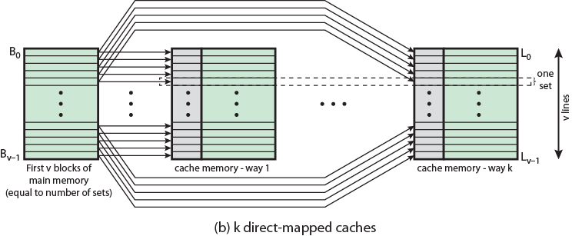
Mapping From Main Memory to Cache: k-way Associative

Slide 7
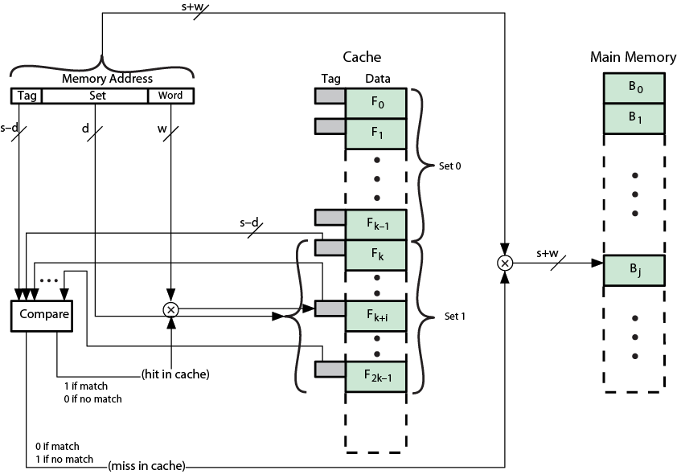
K-Way Set Associative Cache Organization

Slide 8
Set Associative Mapping Address Structure
Word
2 bit
Tag 9 bit
Set 13 bit
Use set field to determine cache set to look in
Compare tag field to see if we have a hit
e.g
Address Tag Data Set number
1FF 7FFC 1FF 12345678 1FFF
001 7FFC 001 11223344 1FFF

Slide 9
Set Associative Mapping Summary
Address length = (s + w) bits
Number of addressable units = 2^{s+w} words or bytes
Block size = line size = 2^{w} words or bytes
Number of blocks in main memory = 2^{s}
Number of lines in set = k
Number of sets = v = 2^{d}
Number of lines in cache = kv = k * 2^{d}
Size of tag = (s – d) bits

Slide 10
Intel Cache Evolution
Problem
Solution
Processor on which feature first appears
External memory slower than the system bus.
Add external cache using faster memory technology.
386
Increased processor speed results in external bus becoming a bottleneck for cache access.
Move external cache on-chip, operating at the same speed as the processor.
486
Internal cache is rather small, due to limited space on chip
Add external L2 cache using faster technology than main memory
486
Contention occurs when both the Instruction Prefetcher and the Execution Unit simultaneously require access to the cache. In that case, the Prefetcher is stalled while the Execution Unit’s data access takes place.
Create separate data and instruction caches.
Pentium
Increased processor speed results in external bus becoming a bottleneck for L2 cache access.
Create separate back-side bus that runs at higher speed than the main (front-side) external bus. The BSB is dedicated to the L2 cache.
Pentium Pro
Move L2 cache on to the processor chip.
Pentium II
Some applications deal with massive databases and must have rapid access to large amounts of data. The on-chip caches are too small.
Add external L3 cache.
Pentium III
Move L3 cache on-chip.
Pentium 4

Slide 11
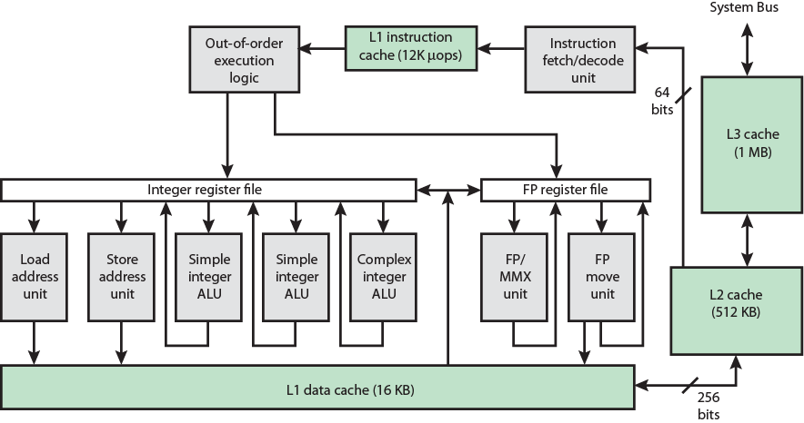
Pentium 4 Block Diagram

Slide 12
Pentium 4 Core Processor
Fetch/Decode Unit
Fetches instructions from L2 cache
Decode into micro-ops
Store micro-ops in L1 cache
Out of order execution logic
Schedules micro-ops
Based on data dependence and resources
May speculatively execute
Execution units
Execute micro-ops
Data from L1 cache
Results in registers
Memory subsystem
L2 cache and systems bus

Slide 13
Pentium 4 Design Reasoning
Decodes instructions into RISC like micro-ops before L1 cache
Micro-ops fixed length
Superscalar pipelining and scheduling
Pentium instructions long & complex
Performance improved by separating decoding from scheduling & pipelining
(More later – ch14)
Data cache is write back
Can be configured to write through
L1 cache controlled by 2 bits in register
CD = cache disable
NW = not write through
2 instructions to invalidate (flush) cache and write back then invalidate
L2 and L3 8-way set-associative
Line size 128 bytes

Slide 14
Question??

Slide 15
Thanks

